Slide 1


Slide 2
OBJECT DETECTION
Under the guidance of:
P. Nagamani,
Professor.
Presented by:
B. Hasini (21-5D5)
B. Chandana (21-5D7)
J. Akash (21-5F2)
G. Sumanth (21-5F1)

Slide 3
Outline
Abstract
Software Requirements
Hardware Requirements
Existing System
Proposed System
Advantages
Disadvantages
Future Scope and Extensions
Conclusion

Slide 4
Abstract
Object Detection aims to provide a solution to the problem of identifying unknown products or items.
We developed an object detection module using open CV in python language that can detect and recognize a good range of products and items.
Users can upload an image to our project website and it will display a brief idea of the product or item along with the nearest stores where it is available.
Our objective is to provide a solution that is efficient, accurate, and easy to use.

Slide 5
Requirements:
Software Requirements:
Operating System: Windows 10
Coding Language: Python 3.8
Web Framework: Flask
Database: MySQL
Web Technologies: HTML and CSS

Slide 6
Requirements:
Hardware Requirements
System: Pentium i3 processor
Hard Disk: 500GB
Monitor: 15” LED
Input Devices: Keyboard, Mouse
Ram : 4GB

Slide 7
Existing System:
In the existing system, Object detection can be done using any of the image processing Algorithms. But that kind of techniques has lots of limitations, make more difficult to recognize the object.

Slide 8
Proposed System:
In proposed approach we are using combination of image processing and machine learning algorithms techniques to detect and track the objects and it will show the object name.

Slide 9
Advantages:
It allows to identify and locate objects in an image or video.
Specifies the location of multiple objects in the image.
It is a powerful tool for tracking activity inside and outside a store.
Helps to improve the security systems in private sectors.
Faster and speed detection.

Slide 10
Disadvantages:
Viewpoint Variation
Deformation
Occlusion
Illumination conditions
Cluttered or Textured Background

Slide 11
Future Scope:
Object Detection is a key ability for most computer and robot vision system.
The Future of object detection technology is in the process of proving itself, and much like the original industrial revolution, it has the potential to free people from menial jobs that can be done more efficiently and effectively by machines.

Slide 12
Conclusion:
The main purpose of object detection is to identify and locate one or more effective targets from still image or video data.
It comprehensively includes a variety of important techniques such as image processing, pattern recognition, artificial intelligence and machine learning.

Slide 13
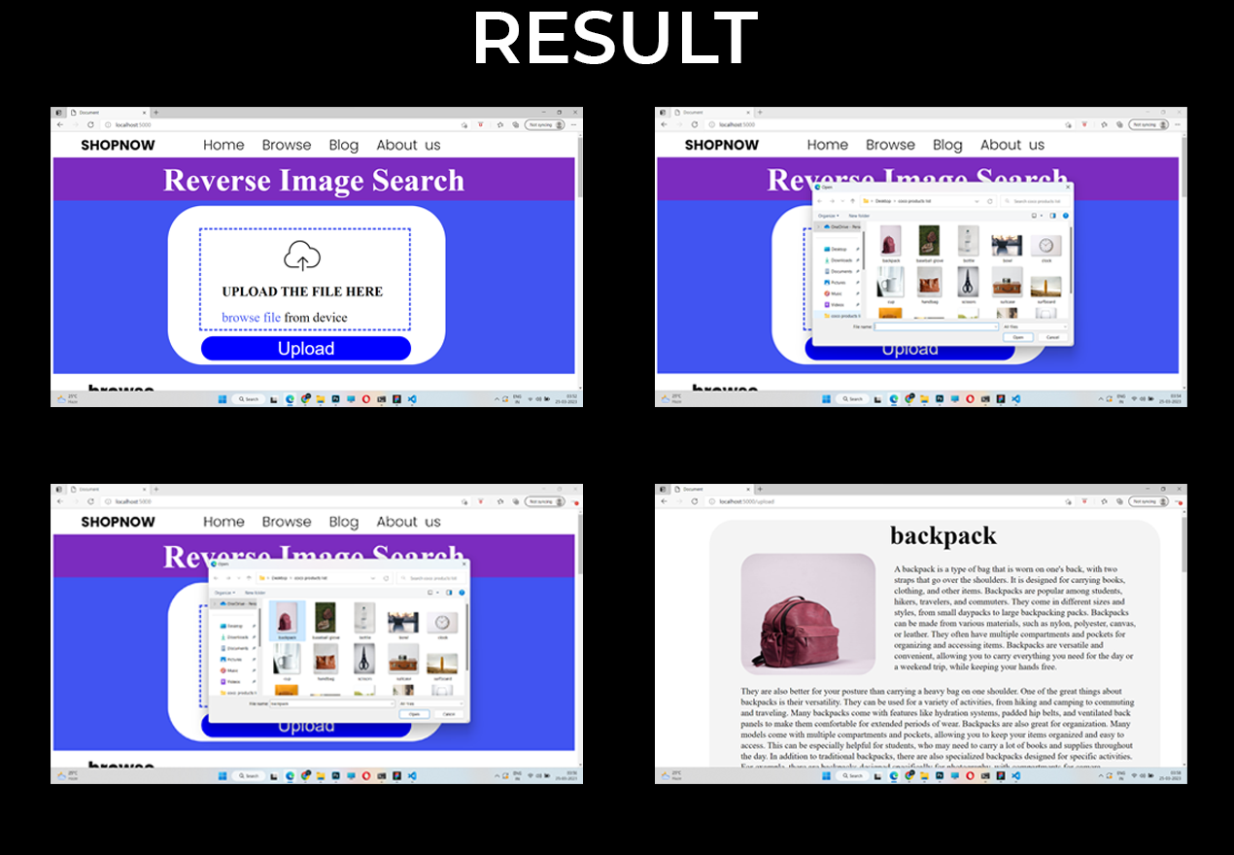

Slide 14
THANK YOU

